Slide 1
Search and Planning
AIMA Chapters 3 and 7
Notes:
This module will introduce a broad class of problems in artificial intelligence called search problems. We can formulate many problems in computer science as search problems, all of which can be solved using the same set of methods.
The problem-solving methods that we’ll look at in this module come from earlier work in algorithms, especially shortest path algorithms. We'll see how we can apply shortest path algorithms to many problems where we need to search through a space of possible sequences of actions in order to reach our desired goal.
In this module, you will learn how to formally define a search problem, and about a range of different algorithms for arriving at a solution for this general mathematical definition of search problems. The class of search algorithms that we’ll be look at in this module is called uninformed search algorithms. The “uninformed” part of the name comes from the fact that we don't have any additional information about the environment that we're exploring. In the next module, we’ll look at how we can use additional information to enhance the search algorithms.
We will look at classic algorithms like depth first search and breadth first search then we'll also look at some interesting variations on them that have some nice computational complexity features.

Slide 2
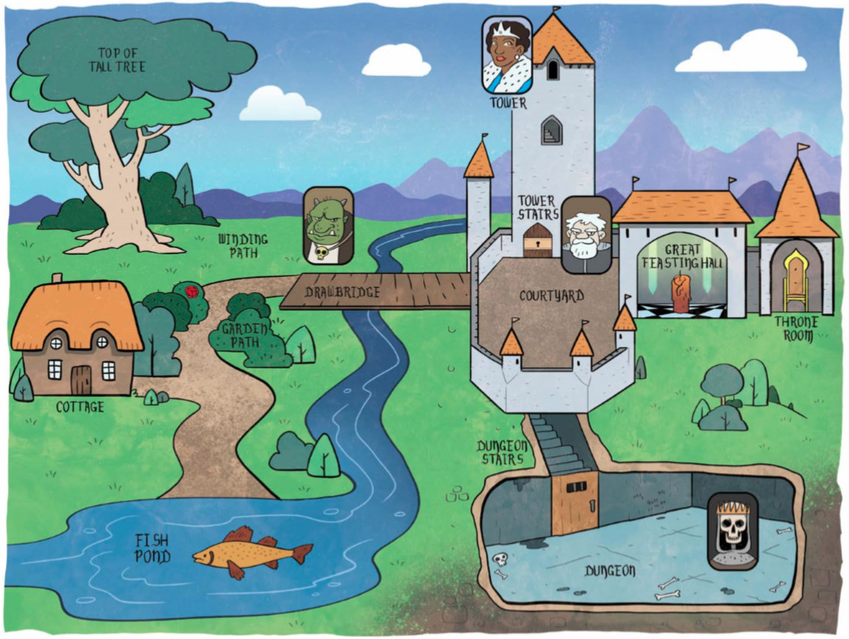
Problem-Solving Agents
A problem-solving agent must plan.
The computational process that it undertakes is called search.
It will consider a sequence of actions that form a path to a goal state.
Such a sequence is called a solution.
take pole
go out
go south
catch fish with pole
go north
pick rose
go north
go up
get branch
go down
go east
give the troll the fish
go east
hit guard with branch
get key
go east
get candle
go west
go down
light lamp
go down
light candle
read runes
get crown
go up
go up
go up
unlock door
go up
give rose to the princess
propose to the princess
down
down
east
east
wear crown
sit on throne
Notes:
A problem solving agent cannot simply pick a single action based on the current percept. Instead, it has a goal in mind and has to plan a sequence of actions in order to reach that goal.
This process of planning a sequence of actions is called search in artificial intelligence. It’s different from what we have commonly come to know as internet search. Instead, the term search refers to the process of searching for a solution, which consists of a sequence of actions from the current state that our agent finds itself in into some desired goal state.
[AR Example]
In this video, I show a problem solving agent. I clicked on certain squares in the grid that I want the agent to visit, indicated by the red dots. The blue dot represents the agent’s starting point, each of the red dots is the point that we want the robot to visit.
The problem solving agent must find a sequence of actions that takes it from that start state to the goal states. The solution is a path. There can be multiple paths from the start state to the goal state. That means there are multiple solutions.
We are interested in the optimal solution. We are going to consider what it means for a solution to be optimal. We will have some criteria to allow us to compare solutions and tell us that this sequence of steps is better than other sequences that also arrive at the goal state.

Slide 3
Review of Search Problems
AIMA 3.1-3.3
Notes:
In module 1, we defined a rational agent as an agent that could select the best action to maximize its performance measure, given an input percept sequence.
Sometimes it isn’t immediately obvious what the best action is to take. In that case, an agent needs to plan ahead and consider many possible sequences of actions. This process of planning ahead from and trying to formulate the best possible sequence of actions is called search. Agents that perform search are called problem-solving agents.

Slide 4
Formal Definition of a Search Problem
States: a set S
An initial state s_{i}∈ S
Actions: a set A
∀ s Actions(s) = the set of actions that can be executed in s.
Transition Model: ∀ s∀ a∈Actions(s) Result(s, a) → s_{r}
s_{r} is called a successor of s
{s_{i} }∪ Successors(s_{i} )* = state space
Path cost (Performance Measure): Must be additive, e.g. sum of distances, number of actions executed, …
c(x,a,y) is the step cost, assumed ≥ 0
(where action a goes from state x to state y)
Goal test: Goal(s)
s is a goal state if Goal(s) is true. Can be implicit, e.g. checkmate(s)

Slide 5
Vacuum World
States: A state of the world says which objects are in which cells.
In a simple two cell version,
the agent can be in one cell at a time
each cell can have dirt or not
2 positions for agent * 2² possibilities for dirt = 8 states.
With n cells, there are n*2^{n} states.
Notes:
Let's now look how our formal definition applies to another search problem that’s described in the textbook. This is a grid world, we have a world that consists of a grid of cells. In this grid world we have a tiny number of cells - just two. Each of the N cells can be dirty or clean. We’ll also have a robot, which can be in one of the cells at any given point in time.
The first thing that we need to formally define to convert this into a search problem is the set of states. Here the states will depend on the number of cells in the gridworld, whether each cell is currently clean or dirty, and the location of the vacuum agent.
For the vacuum cleaner gridworld, how many states are there? We've got two cells which means two possible positions for the agent then we've got for each cell, it can be in one of two conditions, either dirty or clean. The number of unique conditions for N cells is 2 to the power of N.
In this tiny vacuum world, we have 8 possible states. The diagram shows all eight of those possible states.
In general for this vacuum world if we have N cells that we have N times 2^ N possible states.
In our problem definition, when we formulate this as a search problem, we not only have to define what our set of states are, but we also have to designate one as the initial state.
We can pick arbitrarily among all these eight possible states and our algorithms should be able to find the goal state given any of these as starting states.
In addition to defining the set of possible States and designating a start state, we need to define the transition model. What is our set of actions and how do we move between these different eight possible States?

Slide 6
Vacuum World
States: A state of the world says which objects are in which cells.
In a simple two cell version,
the agent can be in one cell at a time
each cell can have dirt or not
2 positions for agent * 2² possibilities for dirt = 8 states.
With n cells, there are n*2^{n} states.
Notes:
Let's now look how our formal definition applies to another search problem that’s described in the textbook. This is a grid world, we have a world that consists of a grid of cells. In this grid world we have a tiny number of cells - just two. Each of the N cells can be dirty or clean. We’ll also have a robot, which can be in one of the cells at any given point in time.
The first thing that we need to formally define to convert this into a search problem is the set of states. Here the states will depend on the number of cells in the gridworld, whether each cell is currently clean or dirty, and the location of the vacuum agent.
For the vacuum cleaner gridworld, how many states are there? We've got two cells which means two possible positions for the agent then we've got for each cell, it can be in one of two conditions, either dirty or clean. The number of unique conditions for N cells is 2 to the power of N.
In this tiny vacuum world, we have 8 possible states. The diagram shows all eight of those possible states.
In general for this vacuum world if we have N cells that we have N times 2^ N possible states.
In our problem definition, when we formulate this as a search problem, we not only have to define what our set of states are, but we also have to designate one as the initial state.
We can pick arbitrarily among all these eight possible states and our algorithms should be able to find the goal state given any of these as starting states.
In addition to defining the set of possible States and designating a start state, we need to define the transition model. What is our set of actions and how do we move between these different eight possible States?

Slide 7
Vacuum World
Goal states: States where everything is clean.
Goal states: States where everything is clean.
States: A state of the world says which objects are in which cells.
In a simple two cell version,
the agent can be in one cell at a time
each cell can have dirt or not
2 positions for agent * 2² possibilities for dirt = 8 states.
With n cells, there are n*2^{n} states.
One state is designated as the initial state
Notes:
Let's now look how our formal definition applies to another search problem that’s described in the textbook. This is a grid world, we have a world that consists of a grid of cells. In this grid world we have a tiny number of cells - just two. Each of the N cells can be dirty or clean. We’ll also have a robot, which can be in one of the cells at any given point in time.
The first thing that we need to formally define to convert this into a search problem is the set of states. Here the states will depend on the number of cells in the gridworld, whether each cell is currently clean or dirty, and the location of the vacuum agent.
For the vacuum cleaner gridworld, how many states are there? We've got two cells which means two possible positions for the agent then we've got for each cell, it can be in one of two conditions, either dirty or clean. The number of unique conditions for N cells is 2 to the power of N.
In this tiny vacuum world, we have 8 possible states. The diagram shows all eight of those possible states.
In general for this vacuum world if we have N cells that we have N times 2^ N possible states.
In our problem definition, when we formulate this as a search problem, we not only have to define what our set of states are, but we also have to designate one as the initial state.
We can pick arbitrarily among all these eight possible states and our algorithms should be able to find the goal state given any of these as starting states.
In addition to defining the set of possible States and designating a start state, we need to define the transition model. What is our set of actions and how do we move between these different eight possible States?

Slide 8
Vacuum World
Move Right
Suck
Actions:
Suck
Move Left
Move Right
(Move Up)
(Move Down)
Transition:
Suck – removes dirt
Move – moves in that direction, unless agent hits a wall, in which case it stays put.
Notes:
In the vacuum world, we have an action to suck up the dirt in the current cell. We have actions where we can go left, right, up and down. In this particular world, we don't really go up or down because it's just two adjacent cells, but in a larger gridworld would also have actions to move up and move down.
From each state we need to define what transition will happen if we apply an action in that state.
We can represent the transitions from state to state as a directed graph. The states are nodes and the actions are directed arcs that transition from one state to another.
For instance … [describe go right, describe suck]

Slide 9
Vacuum World
Right
Left
Suck
Suck
Right
Right
Left
Left
Suck
Suck
Right
Left
Notes:
Here’s the graph for the complete set of states for the 2-cell vacuum world.
Depending on the start state, not all states will be reachable.

Slide 10
Vacuum World
Right
Left
Suck
Suck
Right
Right
Left
Left
Suck
Suck
Action cost:
Uniform (all actions are equal cost)
Right
Left
Notes:
[action cost]
The final thing we need to define is the action costs. In this case, we're just going to say every action has uniform cost, which means every action costs the same. With the action cost, we have a fully defined mathematical representation of this vacuum world.

Slide 11
Vacuum World
Right
Left
Suck
Suck
Right
Right
Left
Left
Suck
Suck
Path cost:
Sum of all action costs along a path
Right
Left

Slide 12
Vacuum World
Initial state
Right
Left
Suck
Suck
Right
Right
Left
Left
Suck
Suck
Solution:
A path from the initial state to a goal state
Right
Left
Goal states

Slide 13
Search Algorithms
Notes:
Let's take a look at a basic search algorithm and see how using it will lead to a tree based representation of the search space.

Slide 14
Useful Concepts
State space: the set of all states reachable from the initial state by any sequence of actions
When several operators can apply to each state, this gets large very quickly
Might be a proper subset of the set of configurations
Path: a sequence of actions leading from one state s_{j} to another state s_{k}
Solution: a path from the initial state s_{i} to a state s_{f} that satisfies the goal test
Search tree: a way of representing the paths that a search algorithm has explored. The root is the initial state, leaves of the tree are successor states.
Frontier: those states that are available for expanding (for applying legal actions to)
Notes:
As we start to formulate algorithms for solving search problems there are a number of concepts that will be useful. We’ve seen a couple of these concepts already.
One is the state space. That is the space of possible states that are reachable from the initial state by taking any possible sequence of actions. When we have a large number of actions that are possible from every state, then the state space is going to get large very early in the search.
Sometimes not all possible states are reachable from an initial state. In the 8-puzzle, you can’t get to every possible permutation of numbers from a given start state.
We’ve already seen the notion of a path, which is a sequence of actions that leads us from one state to another.
A solution is a path from the initial state to a state that satisfies our goal test.
Search algorithms, will start with initial state , expand it to get its successor states, and then expand those successors.
We’ll see that the process of searching can be represented as a search tree, where the root is the initial state, its branches are the actions to expand to a successor state, and the leaves are succsor states several layers down that haven’t been expanded yet. The tree’s branching factor will be determined by how many actions we can take at each state.
Along with the search tree is a concept that we call the frontier, which is going to be all the States that we have available to expand, meaning the successor states which we can pick from to apply an action to, in order to take the next step towards the solution.

Slide 15
Solutions and Optimal Solutions
A solution is a sequence of actions from the initial state to a goal state.
Optimal Solution: A solution is optimal if no solution has a lower path cost.
Notes:
A solution is simply a sequence of actions that takes us from the initial state to the goal state. There are many possible ways of moving from the initial state to a goal state. Some of them have a lower path costs than others.
Given our path cost definition, we are really interested in which solution is better than all of the others. This is called the optimal solution.
A solution is optimal if there is no other solutions that have a lower path cost than this solution. That's going to be a key to evaluate the goodness of the algorithms we've designed are guaranteed to result in an optimal solution.

Slide 16
Basic search algorithms: Tree Search
Generalized algorithm to solve search problems
Enumerate in some order all possible paths from the initial state
Here: search through explicit tree generation
ROOT= initial state.
Nodes in search tree generated through transition model
Tree search treats different paths to the same node as distinct
Notes:
We're going to talk about the tree search algorithm, which is a generalized algorithm for solving a search problem. The way that the algorithm performs search is to build a tree based data structure that represents the space of States that we have searched.
Each node in the tree contains a state. The edges between two nodes represent an action that is taken by applying our transition function to the state in the parent node. And returning the state and the child node.
The root of the tree is the initial state. The tree is built by first applying all the actions that are available on the initial state. Each action represents a branch.
Leaf nodes can be expanded in the same way that the root node was expanded. We will expand these nodes in a particular order. The order that we expand the nodes in will determine the type of search that we're doing.
We'll see in a moment, another kind of basic search algorithm called the graph search. The key difference between tree search and graph search is that tree search treats different paths to the same node as distinct.

Slide 17
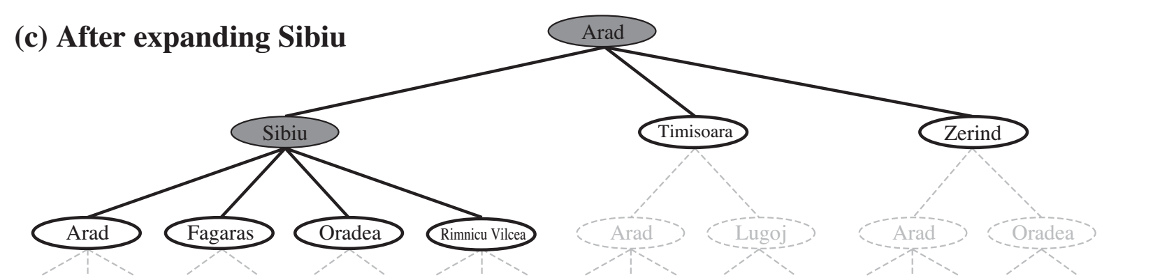
Generalized tree search
function TREE-SEARCH(problem, strategy) return a solution or failure
Initialize frontier to the initial state of the problem
do
if the frontier is empty then return failure
choose leaf node for expansion according to strategy & remove from frontier
if node contains goal state then return solution
else expand the node and add resulting nodes to the frontier
The strategy determines search process!
Notes:
Here's what tree search looks like for the map problem. The root of the tree is our initial state of Arad. The next layer of the tree consists of the nodes that are generated by applying our transition function to Arad. These are the three cities that are the ones that are adjacent to Arad on the map. They're the ones that we can reach by taking a single action from Arad.
Any of these three nodes can be expanded in the same way that the root node was expanded. And the result is a tree .
Below is the code for the tree search algorithm. The tree search algorithm will take as input a search problem, including the initial state, the transition function and all those other details.
It will return a solution to the search problem. It'll also take in something called a strategy, which is going to determine the order in which we expand the nodes.
The first step of the tree search function is to initialize the frontier. The frontier keeps track of all the states that are available to be expanded. We'll see that a priority queue is a good data structure to use for the frontier.
Initially, we put the problem's start state onto the frontier. In the pseudo code we then enter a do loop that keeps running until the frontier is empty, or until we reach a goal state.
If the frontier is empty, then there is no solution to our search problem, so we return a variable that denotes failure to find a solution. In Python we might use the None variable to represent failure.
If there are still nodes in the frontier, then we can continue searching for a solution. We select a node from the frontier and check to see whether it is one of our goal states.
If so, we've found a solution to the search problem. The solution can be computed by walking up the tree, starting at the current node, containing the goal state and going back up layer by layer until we reached the root node.
As we're doing this, we can record each action that was taken along the path. That'll form the solution.
If the node that is removed from the frontier is not a goal state, it can be expanded. All of the nodes on the frontier are leaf nodes on the search tree. They are called leaf nodes because they have not yet been expanded and therefore do not have any nodes beneath them.
When we remove a node from the frontier, we expand it by applying the transition function to all of the actions that are available for its state. That creates children nodes that are then added to the frontier.
the strategy that we use to pick which elements of the frontier to expand will result in different kinds of search. For instance, a different strategy could result in a depth versus search or a breadth first search.

Slide 18
8-Puzzle Search Tree
Start State
7 | 2 | 4
5 |  | 6
8 | 3 | 1
Max Branching Factor = 4
Action: Down
Action: Up
Action: Right
Action: Move Blank Tie Left
7 | 2 | 4
 | 5 | 6
8 | 3 | 1
7 |  | 4
5 | 2 | 6
8 | 3 | 1
7 | 2 | 4
5 | 6
8 | 3 | 1
Right
Up
Down
7 | 2 | 4
5 |  | 6
8 | 3 | 1
 | 2 | 4
7 | 5 | 6
8 | 3 | 1
7 | 2 | 4
8 | 5 | 6
 | 3 | 1
7 | 2 | 4
5 |  | 6
8 | 3 | 1
 | 7 | 4
5 | 2 | 6
8 | 3 | 1
7 | 4
5 | 2 | 6
8 | 3 | 1
7 | 2 | 4
5 |  | 6
8 | 3 | 1
7 | 2
5 | 6 | 4
8 | 3 | 1
7 | 2 | 4
5 | 6 | 1
8 | 3
Notes:
Here's an example of a search tree for the eight puzzle. The root node of this search tree is an initial state of the puzzle. The four nodes immediately underneath the root node contain a state that is reachable from the start state by applying one action.
Remember that nodes are data structures that contain a variety of information like pointers to the parent and children, the action that was taken, the depth and the tree, the path cost, and so on. I'm not explicitly representing that information in this figure, but it would be contained in a node's data structure.
One of the things that I'm suppressing in this figure is backwards moves. I'm not showing this in the search diagram, but for instance, if I took the left child here from the root node then it could have a third child, which was just moving back to the start state.
However, going back to a previous state is going to be useless since it will increase the cost of the solution. Redundant loops, meaning going through the same state repeatedly, are therefore bad. In general for search problems the notion of repeatedly visiting the same state is going to be a problem that search algorithms should address.

Slide 19
8-Puzzle Search Tree
7 | 2 | 4
5 |  | 6
8 | 3 | 1
7 | 2 | 4
 | 5 | 6
8 | 3 | 1
7 |  | 4
5 | 2 | 6
8 | 3 | 1
7 | 2 | 4
5 | 6
8 | 3 | 1
Repeated State
7 | 2 | 4
5 |  | 6
8 | 3 | 1
 | 2 | 4
7 | 5 | 6
8 | 3 | 1
7 | 2 | 4
8 | 5 | 6
 | 3 | 1
7 | 2 | 4
5 |  | 6
8 | 3 | 1
 | 7 | 4
5 | 2 | 6
8 | 3 | 1
7 | 4
5 | 2 | 6
8 | 3 | 1
7 | 2 | 4
5 |  | 6
8 | 3 | 1
7 | 2
5 | 6 | 4
8 | 3 | 1
7 | 2 | 4
5 | 6 | 1
8 | 3
Notes:
Here's an example of a search tree for the eight puzzle. The root node of this search tree is an initial state of the puzzle. The four nodes immediately underneath the root node contain a state that is reachable from the start state by applying one action.
Remember that nodes are data structures that contain a variety of information like pointers to the parent and children, the action that was taken, the depth and the tree, the path cost, and so on. I'm not explicitly representing that information in this figure, but it would be contained in a node's data structure.
One of the things that I'm suppressing in this figure is backwards moves. I'm not showing this in the search diagram, but for instance, if I took the left child here from the root node then it could have a third child, which was just moving back to the start state.
However, going back to a previous state is going to be useless since it will increase the cost of the solution. Redundant loops, meaning going through the same state repeatedly, are therefore bad. In general for search problems the notion of repeatedly visiting the same state is going to be a problem that search algorithms should address.

Slide 20
Graph Search vs Tree Search
function TREE-SEARCH(problem) returns a solution, or failure
initialize the frontier using the initial state of problem
loop do
if the frontier is empty then return failure
choose a leaf nose and remove it from the frontier
if the node contains a goal state then return the corresponding solution
expand the chosen node, adding the resulting nodes to the frontier
function GRAPH-SEARCH(problem) returns a solution, or failure
initialize the frontier using the initial state of problem
initialize the explored set to be empty
loop do
if the frontier is empty then return failure
choose a leaf node and remove it from the frontier
if the node contains a goal state then return the corresponding solution
add node to the explored set
expand the chosen node, adding the resulting nodes to the frontier
only if not in the frontier of explored set
Notes:
Here's a side-by-side comparison of the pseudo code for tree search versus the pseudo code for graph search. The graph search function introduces a new auxiliary data structure called the explored set. The explored set is initially set to be empty .
Within the loop every time we remove a leaf from the frontier, we add its state to the explored set to ensure that we don't repeatedly visit that state. Whenever we expand the chosen node we first check to see whether the new nodes are in the explored set before we add them to the frontier. We don't add the new nodes to the frontier if they've already been explored. This ensures that we do not repeatedly visit the same state.

Slide 21
Search Strategies
Several classic search algorithms differ only by the order of how they expand their search trees
You can implement them by using different queue data structures
Depth-first search = LIFO queue
Breadth-first search = FIFO queue
Greedy best-first search or A* search = Priority queue
Notes:
Ask students: What does LIFO stand for? What does FIFO stand for?
Which is a Stack? (LIFO)
What do we mean by a search strategy? A search strategy provides the order in which we expand the nodes that are in the frontier queue.
The way that we handle the ordering of the frontier queue when we implement a search algorithm is via a queue.
There are several different kinds of queue. Each of them have a different ordering in how items are dequeued. The 3 kinds of queues are:
a LIFO queue has a “Last In First Out” order. Meaning the item that was most recently added to the queue will be the thing that we dequeue next.
a FIFO queue has a “Last In First Out” order. This means that the item that was least recently added to the queue will be the first thing that we dequeue.
A priority queue will allow us to assign a value to each item as we enqueue it. This will allow us to control the order in which things get dequeued in interesting ways.
By implementing that frontier as these different kinds of queues, we will change the order that it expands nodes on the frontier. We can change our search strategy from a depth-first search strategy to a breadth-first search strategy, simply by replacing a LIFO queue with a FIFO.
Depending on which strategy we give it, the search will have different behaviors. There are several ways that we will evaluate the behaviors of a search strategy.
The first is completeness. Is this search strategy always guaranteed to find a solution if one exists? If so, it is complete. If not, it is not complete.
The next is optimality - does it always return the lowest cost solution first? An optimal search
is guaranteed to return a solution that has the lowest path cost, compared to any other possible.
We will also evaluate the complexity of search strategies both in terms of their running time and in terms of the amount of memory that they will use (their space complexity).
When we are doing our complexity analysis of search strategies, there are several variables that we’ll use repeatedly. Here are the variables and their definitions:
b is the branching factor. This is going to be the maximum set of possible actions that I can take from any state to get to any other state.
d will represent the depth of a goal node in my search tree. If there are multiple goal nodes then d corresponds to the shallowest depth of any of the goal nodes.
the variable m will represent the maximum length of any path in the search space. If the graph is cyclic then some search strategies can get stuck in infinite loops. Sometimes the search spaces themselves are infinite which also means m could be infinite.

Slide 22
8-Puzzle Breadth-first search
Start State
7 | 2 | 4
5 |  | 6
8 | 3 | 1
Action: Down
Action: Up
Action: Right
Action: Move Blank Tie Left
7 | 2 | 4
 | 5 | 6
8 | 3 | 1
7 |  | 4
5 | 2 | 6
8 | 3 | 1
7 | 2 | 4
5 | 6
8 | 3 | 1
Right
Up
Down
7 | 2 | 4
5 |  | 6
8 | 3 | 1
 | 2 | 4
7 | 5 | 6
8 | 3 | 1
7 | 2 | 4
8 | 5 | 6
 | 3 | 1
7 | 2 | 4
5 |  | 6
8 | 3 | 1
 | 7 | 4
5 | 2 | 6
8 | 3 | 1
7 | 4
5 | 2 | 6
8 | 3 | 1
7 | 2 | 4
5 |  | 6
8 | 3 | 1
7 | 2
5 | 6 | 4
8 | 3 | 1
7 | 2 | 4
5 | 6 | 1
8 | 3
Notes:
Here's an example of a search tree for the eight puzzle. The root node of this search tree is an initial state of the puzzle. The four nodes immediately underneath the root node contain a state that is reachable from the start state by applying one action.
Remember that nodes are data structures that contain a variety of information like pointers to the parent and children, the action that was taken, the depth and the tree, the path cost, and so on. I'm not explicitly representing that information in this figure, but it would be contained in a node's data structure.
One of the things that I'm suppressing in this figure is backwards moves. I'm not showing this in the search diagram, but for instance, if I took the left child here from the root node then it could have a third child, which was just moving back to the start state.
However, going back to a previous state is going to be useless since it will increase the cost of the solution. Redundant loops, meaning going through the same state repeatedly, are therefore bad. In general for search problems the notion of repeatedly visiting the same state is going to be a problem that search algorithms should address.

Slide 23
Search Algorithms
Dimensions for evaluation
Completeness- always find the solution?
Optimality - finds a least cost solution (lowest path cost) first?
Time complexity - # of nodes generated (worst case)
Space complexity - # of nodes simultaneously in memory (worst case)
Time/space complexity variables
b, maximum branching factor of search tree
d, depth of the shallowest goal node
m, maximum length of any path in the state space (potentially ∞)
Notes:
Ask students: What does LIFO stand for? What does FIFO stand for?
Which is a Stack? (LIFO)
What do we mean by a search strategy? A search strategy provides the order in which we expand the nodes that are in the frontier queue.
The way that we handle the ordering of the frontier queue when we implement a search algorithm is via a queue.
There are several different kinds of queue. Each of them have a different ordering in how items are dequeued. The 3 kinds of queues are:
a LIFO queue has a “Last In First Out” order. Meaning the item that was most recently added to the queue will be the thing that we dequeue next.
a FIFO queue has a “Last In First Out” order. This means that the item that was least recently added to the queue will be the first thing that we dequeue.
A priority queue will allow us to assign a value to each item as we enqueue it. This will allow us to control the order in which things get dequeued in interesting ways.
By implementing that frontier as these different kinds of queues, we will change the order that it expands nodes on the frontier. We can change our search strategy from a depth-first search strategy to a breadth-first search strategy, simply by replacing a LIFO queue with a FIFO.
Depending on which strategy we give it, the search will have different behaviors. There are several ways that we will evaluate the behaviors of a search strategy.
The first is completeness. Is this search strategy always guaranteed to find a solution if one exists? If so, it is complete. If not, it is not complete.
The next is optimality - does it always return the lowest cost solution first? An optimal search
is guaranteed to return a solution that has the lowest path cost, compared to any other possible.
We will also evaluate the complexity of search strategies both in terms of their running time and in terms of the amount of memory that they will use (their space complexity).
When we are doing our complexity analysis of search strategies, there are several variables that we’ll use repeatedly. Here are the variables and their definitions:
b is the branching factor. This is going to be the maximum set of possible actions that I can take from any state to get to any other state.
d will represent the depth of a goal node in my search tree. If there are multiple goal nodes then d corresponds to the shallowest depth of any of the goal nodes.
the variable m will represent the maximum length of any path in the search space. If the graph is cyclic then some search strategies can get stuck in infinite loops. Sometimes the search spaces themselves are infinite which also means m could be infinite.

Slide 24
Properties of breadth-first search
Complete? Yes (if b is finite)
Optimal? Yes, if cost = 1 per step (not optimal in general)
Time Complexity? 1+b+b²+b³+… +b^{d} = O(b^{d})
Space Complexity? O(b^{d}) (keeps every node in memory)
Time/space complexity variables
b, maximum branching factor of search tree
d, depth of the shallowest goal node
m, maximum length of any path in the state space (potentially ∞)
Notes:
Draw search tree on board.
An exponential complexity bound such as O(b^d) is SCARY!
Would this be optimal for the Romanian Map example? No.
Would this be optimal for the 8-puzzle
Let’s take a moment to analyze the properties of breadth first search.
Is BFS complete, is it guaranteed to find a solution? And the answer is yes if the branching factor is finite.
Is BFS optimal? Guaranteed to return the shortest path as the solution?
The answer is yes, under the condition that every action has an equivalent cost.
If every action costs one like in the 8-puzzle, then BFS is guaranteed to find the solution that's shallowest in the tree.
However, if our costs from traveling one to another node is variable, like in a map task where the cost is the number of miles traveled or the time to get between two cities, then BFS isn't optimal and it's not guaranteed to find the shortest path first.
We’ll see related search algorithms that let us find the shortest paths through weighted graphs instead of unweighted graphs.
We can analyze the runtime complexity of it. First, insert the first node as the initial state. Then go through each of the possible children of the initial state. Then go through each of the possible children of the first layer of children and each of the possible children of the next layer.
That's going to be 1 + b + b ^2 + b ^ 3 + ..., because we're just branching our factor depending on our layers up to the maximum depth of the shallowest goal node.
The asymptotic complexity is to only pay attention to that last factor b to the power of d.
Because we're recording every node that we visited in our our data structure, so that we don't look through the same thing again. The space complexity is going to be the same as O(b^d).
Note that this running time is fine for small problems where the depth of the least cost solution is small. However, the exponential means that for larger values of d, BFS will take a long time to compute a solution and a lot of memory. In general, exponential complexity search problems cannot be solved by uninformed search for anything but the smallest problems.

Slide 25
BFS versus DFS
Time/space complexity variables
b, maximum branching factor of search tree
d, depth of the shallowest goal node
m, maximum length of any path in the state space (potentially ∞)
Breadth-first
🗹 Complete,
🗹 Optimal 🗷 but uses O(b^{d}) space
Depth-first
🗷 Not complete unless m is bounded
🗷 Not optimal
🗷 Uses O(b^{m}) time; terrible if m >> d
🗹 but only uses O(b*m) space
Notes:
1. Breadth-first only for small spaces.
2. Depth-first only for known solution depth and admissibility not important.

Slide 26
Exponential Space (and time) Is Not Good...
Exponential complexity uninformed search problems cannot be solved for any but the smallest instances.
(Memory requirements are a bigger problem than execution time.)
Assumes b=10, 1M nodes/sec, 1000 bytes/node
DEPTH | NODES | TIME | MEMORY
2 | 110 | 0.11 milliseconds | 107 kilobytes
4 | 11110 | 11 milliseconds | 10.6 megabytes
6 | 10⁶ | 1.1 seconds | 1 gigabytes
8 | 10⁸ | 2 minutes | 103 gigabytes
10 | 10¹⁰ | 3 hours | 10 terabytes
12 | 10¹² | 13 days | 1 petabytes
14 | 10¹⁴ | 3.5 years | 99 petabytles
Notes:
Let’s really hammer home the importance of that exponential in the complexity.
The only way that we're able to explore any search problem is if there's going to be tiny instances.
This will especially come through not just in the time complexity, but also in the memory requirements.
Two lessons can be learned from Figure 3.13.
1) the memory requirements are a bigger problem for breadth-first search than is the execution time. One might wait 13 days for the solution to an important problem with search depth 12, but no personal computer has the petabyte of memory it would take. Fortunately, other strategies require less memory.
2) time is still a major factor. If your problem has a solution at depth 16, then (given our assumptions) it will take about 350 years for breadth-first search (or indeed any uninformed search) to find it. In general, exponential-complexity search problems cannot be solved by uninformed methods for any but the smallest instances.

Slide 27
Search and Planning
AIMA Chapters 3 and 7
Notes:
This module will introduce a broad class of problems in artificial intelligence called search problems. We can formulate many problems in computer science as search problems, all of which can be solved using the same set of methods.
The problem-solving methods that we’ll look at in this module come from earlier work in algorithms, especially shortest path algorithms. We'll see how we can apply shortest path algorithms to many problems where we need to search through a space of possible sequences of actions in order to reach our desired goal.
In this module, you will learn how to formally define a search problem, and about a range of different algorithms for arriving at a solution for this general mathematical definition of search problems. The class of search algorithms that we’ll be look at in this module is called uninformed search algorithms. The “uninformed” part of the name comes from the fact that we don't have any additional information about the environment that we're exploring. In the next module, we’ll look at how we can use additional information to enhance the search algorithms.
We will look at classic algorithms like depth first search and breadth first search then we'll also look at some interesting variations on them that have some nice computational complexity features.

Slide 28
Problem-Solving Agents
A problem-solving agent must plan.
The computational process that it undertakes is called search.
It will consider a sequence of actions that form a path to a goal state.
Such a sequence is called a solution.
take pole
go out
go south
catch fish with pole
go north
pick rose
go north
go up
get branch
go down
go east
give the troll the fish
go east
hit guard with branch
get key
go east
get candle
go west
go down
light lamp
go down
light candle
read runes
get crown
go up
go up
go up
unlock door
go up
give rose to the princess
propose to the princess
down
down
east
east
wear crown
sit on throne
Notes:
A problem solving agent cannot simply pick a single action based on the current percept. Instead, it has a goal in mind and has to plan a sequence of actions in order to reach that goal.
This process of planning a sequence of actions is called search in artificial intelligence. It’s different from what we have commonly come to know as internet search. Instead, the term search refers to the process of searching for a solution, which consists of a sequence of actions from the current state that our agent finds itself in into some desired goal state.
[AR Example]
In this video, I show a problem solving agent. I clicked on certain squares in the grid that I want the agent to visit, indicated by the red dots. The blue dot represents the agent’s starting point, each of the red dots is the point that we want the robot to visit.
The problem solving agent must find a sequence of actions that takes it from that start state to the goal states. The solution is a path. There can be multiple paths from the start state to the goal state. That means there are multiple solutions.
We are interested in the optimal solution. We are going to consider what it means for a solution to be optimal. We will have some criteria to allow us to compare solutions and tell us that this sequence of steps is better than other sequences that also arrive at the goal state.

Slide 29
Action Castle
Notes:
In module 1, we defined a rational agent as an agent that could select the best action to maximize its performance measure, given an input percept sequence.
Sometimes it isn’t immediately obvious what the best action is to take. In that case, an agent needs to plan ahead and consider many possible sequences of actions. This process of planning ahead from and trying to formulate the best possible sequence of actions is called search. Agents that perform search are called problem-solving agents.

Slide 30
Art: Formulating a Search Problem
Decide:
Which properties matter & how to represent
Initial State, Goal State, Possible Intermediate States
Which actions are possible & how to represent
Operator Set: Actions and Transition Model
Which action is next
Path Cost Function
Formulation greatly affects combinatorics of search space and therefore speed of search
Notes:
There is an art of casting a problem as a search problem. The question we need to consider is: how do I take this real world problem, and then represent it in a way that’s compatible with our formal definition of a search problem. There are many ways that I might defining a set of states, a transition function, and the possible actions, etc.
The way that I choose to represent the states and the actions is going to have a huge impact on the speed of our search algorithms. If I increase the size of my state space by including elements of the real world that aren’t important to the search formulation, or if I include more actions than are necessary, then I may dramatically slow down the search because of the combinatorics of combing those things during the search process.

Slide 31
Action Castle Map Navigation
Let’s consider the sub-task of navigating from one location to another.
Formulate the search problem
States: locations in the game
Actions: move between connected locations
Goal: move to a particular location like the Throne Room
Performance measure: minimize number of moves to arrive at the goal
Find a solution
Algorithm that returns sequence of actions to get from the start sate to the goal.

Slide 32
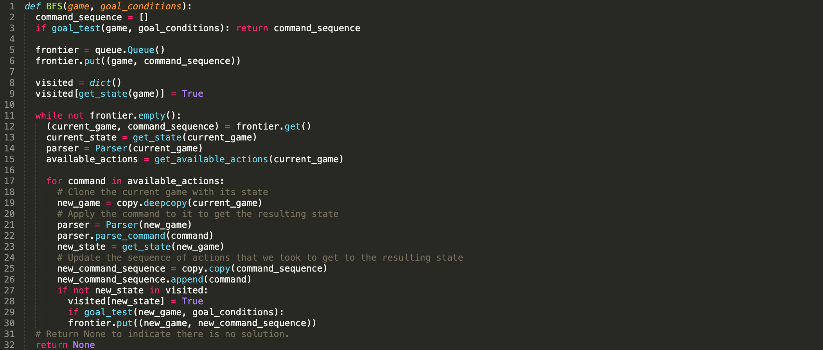
The frontier tracks order of unexpanded search nodes. Here we’re using a FIFO queue
The visited dictionary prevents us from revising states.
TODO: implement get_state()
get_available_actions() to return all commands that could be used here.
TODO: implement get_available_actions()
The parser can execute this command to get the resulting state.
Check to see if this state satisfies the goal test, if so, return the command sequence that got us here.
TODO: implement goal_test()

Slide 33
Tip: We can store multiple objects on the frontier as a tuple.
Tip: To be used a key in the dictionary get_state() must return an immutable object
Tip: use deepcopy here
Tip: For BFS, apply the goal test before putting the new item on the frontier

Slide 34
Action Castle
Let’s consider the full game.
Actions
Start State
Transitions
State Space
Goal test

Slide 35
Actions
Go Move to a location
Get
Add an item to inventory
Special
Perform a special action with an item like “Catch fish with pole”
Drop
Leave an item in current location
Notes:
Are all actions always available? No.
What is the maximum branching factor?
go * number of directions +
get * number of items in location +
drop * number of items in inventory
special * (number of items in location + number of items in inventory) +

Slide 36
State Info
Location of Player
Items in their inventory
Location of all items / NPCs
Blocks like
Troll guarding bridge,
Locked door to tower,
Guard barring entry to castle
Notes:
Are all actions always available? No.
What is the maximum branching factor?
go * number of directions +
get * number of items in location +
drop * number of items in inventory
special * (number of items in location + number of items in inventory) +

Slide 37
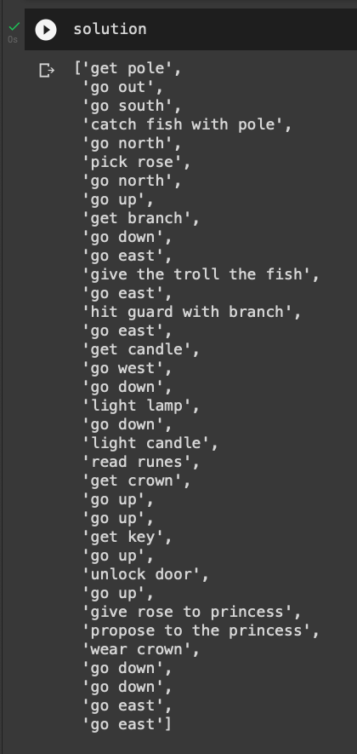
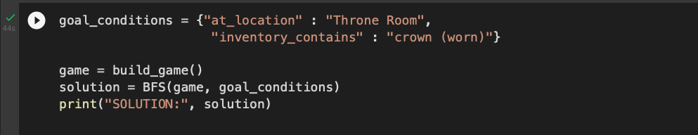

My Solution

Slide 38
Classical Planning
AIMA Chapter 11
Notes:
In module 1, we defined a rational agent as an agent that could select the best action to maximize its performance measure, given an input percept sequence.
Sometimes it isn’t immediately obvious what the best action is to take. In that case, an agent needs to plan ahead and consider many possible sequences of actions. This process of planning ahead from and trying to formulate the best possible sequence of actions is called search. Agents that perform search are called problem-solving agents.

Slide 39
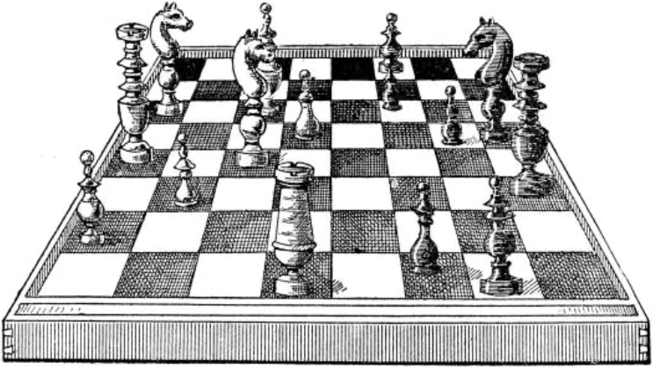

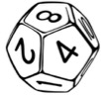
Classical Planning
The task of finding a sequence of action to accomplish a goal in a deterministic, fully-observable, discrete, static environment.
If an environment is:
Deterministic
Fully observable
The solution to any problem in such an environment is a fixed sequence of actions.
In environments that are
Nondeterministic or
Partially observable
The solution must recommend different future actions depending on the what percepts it receives. This could be in the form of a branching strategy.
Notes:
In module 1, we discussed task environments. The different qualities of the task environment impact the nature of the solutions to search problems.
[observable environment example]
Recall that we divided environments into fully observable environments versus partially observable ones. This reflects the difference between playing chess, where we see the complete state of the board at any given point in time vs. self-driving cars where we can't observe the entire environment and some elements of the environment are hidden
Chess is fully-observable and self-driving cars operate in partially observable task environments.
[deterministic example]
Similarly, we talked about other types of task environments where either the action that we selected would have a deterministic result. If we choose to move our Knight in chess, we know exactly where it will end up, because the results of making a move in chess is deterministic. In non-deterministic environments where an agent selects an action, the outcome may or may not be what it expects.
Later on in the course, we'll address stochastic environments, which are non-deterministic. In such environments, the outcome is uncertain, but we have an expectation of how likely each possible resulting state is, given that action that we've selected.
For this module, we will focus on fully observable, deterministic environments, where everything is known. If we have that kind of particular task environment, then the solution to any problem that we can formulate as a search problem is going to be a fixed sequence of actions.
This means that there can be an ordered list of actions that the agent can execute to move from its initial state to its goal state.
If we get into more complex environments where we either don't have all the information available when we're computing our solution, or when actions are non-deterministic then we need a different kind of solution. Instead a fixed sequence of actions, instead, we need to have a contingency plan. If I observed this outcome at this particular step in the sequence, then do this, otherwise do this.
We’ll begin by developing solutions for search problems in fully observable, deterministic environments where everything is known.

Slide 40
Representation Language
Planning Domain Definition Language (PDDL) express actions as a schema
Action name
(:action get :parameters (?item - item ?p - player ?l1 - location ) :precondition (and (at ?p ?l1) (at ?item ?l1)) :effect (and (inventory ?p ?item) (not (at ?item ?l1))) )
Variables
Preconditions
Effects
These logical sentences are literals – positive or negated atomic sentences
Preconditions and effects are conjunctions of logical sentences
Notes:
Preconditions and Effects are conjunctions of literals (positive or negated atomic sentences)
Rather than having to implement specific actions for ‘go west’, ‘go east’, ‘go out’ etc. we can just use one ‘go’ action.

Slide 41
Representation Language
Planning Domain Definition Language (PDDL) express actions as a schema
Action name
Variables
(:action go :parameters (?dir - direction
?p - player
?l1 - location ?l2 - location) :precondition (and
(at ?p ?l1)
(connected ?l1 ?dir ?l2)
(not (blocked ?l1 ?dir ?l2))) :effect (and
(at ?p ?l2)
(not (at ?p ?l1))) )
Preconditions
Preconditions and effects are conjunctions of logical sentences
Effects
These logical sentences are literals – positive or negated atomic sentences
Notes:
Preconditions and Effects are conjunctions of literals (positive or negated atomic sentences)
Rather than having to implement specific actions for ‘go west’, ‘go east’, ‘go out’ etc. we can just use one ‘go’ action.

Slide 42
State Representation
In PDDL, a state is represented as a conjunction of logical sentences that are ground atomic fluents. PDDL uses database semantics.
Closed world assumption. Any fluent not mentioned is false. Unique names are distinct.
Ground means they contain no variables
Atomic sentences contain just a single predicate
Fluent means an aspect of the world that can change over time.
Action Schema has variables
(:action go :parameters (?dir - direction ?p - player ?l1 - location ?l2 - location) :precondition (and (at ?p ?l1) (connected ?l1 ?dir ?l2) (not (blocked ?l1 ?dir ?l2))) :effect (and (at ?p ?l2) (not (at ?p ?l1))) )
State Representation
arguments are constants fluents may change over time
(connected cottage out gardenpath) (connected gardenpath in cottage) (connected gardenpath south fishingpond) (connected fishingpond north gardenpath) (at npc cottage)

Slide 43
Successor States
A ground action is applicable if if every positive literal in the precondition is true, and every negative literal in the precondition is false
Ground Action no variables
(:action go :parameters (out, npc, cottage, gardenpath) :precondition (and (at npc cottage) (connected cottage out gardenpath) (not (blocked cottage out gardenpath))) :effect (and (at npc gardenpath) (not (at npc cottage))) )
Initial State
(connected cottage out gardenpath) (connected gardenpath in cottage) (connected gardenpath south fishingpond) (connected fishingpond north gardenpath) (at npc cottage)
Negative literals in the effects are kept in a delete list DEL(), and positive literals are kept in an add list ADD()
Result New state reflecting the effect of applying the ground action
(connected cottage out gardenpath) (connected gardenpath in cottage) (connected gardenpath south fishingpond) (connected fishingpond north gardenpath) (at npc gardenpath)

Slide 44
Domain
Problem
Set of Action Schema
(define (domain action-castle) (:requirements :strips :typing) (:types player location direction item) (:action go :parameters (?dir - direction ?p - player
?l1 - location ?l2 - location) :precondition (and (at ?p ?l1)
(connected ?l1 ?dir ?l2)
(not (blocked ?l1 ?dir ?l2))) :effect (and (at ?p ?l2) (not (at ?p ?l1))) ) (:action get :parameters (?item - item
?p - player
?l1 - location ) :precondition (and (at ?p ?l1)
(at ?item ?l1)) :effect (and (inventory ?p ?item)
(not (at ?item ?l1))) ) )
(define (problem navigate-to-location) (:domain action-castle) (:objects npc - player cottage gardenpath fishingpond gardenpath
windingpath talltree drawbridge courtyard
towerstairs tower dungeonstairs dungeon
greatfeastinghall throneroom - location in out north south east west up down - direction ) (:init (at npc cottage) (connected cottage out gardenpath) (connected gardenpath in cottage) (connected gardenpath south fishingpond) (connected fishingpond north gardenpath) ) (:goal (and (at npc throneroom))) )
Initial State
Goal

Slide 45
Algorithms for Classical Planning
We can apply BFS to the initial state through possible states looking for a goal.
An advantage of the declarative representation of action schemas is that we can also search backwards.
Start with a goal and work backwards towards the initial state.
In our Action Castle example, this would help us with the branching problem that the drop action introduced. If we work backwards from the goal, then we realize that we don’t ever need to drop an item for the correct solution.
Why work backwards?

Slide 46
Forward State-Space Search for Planning
Ground action with no variables
At(Player, Fishing Pond) At(Pole, Cottage)
Go South
At(Player, Garden Path) At(Pole Cottage)
Go Horth
At(Player, Garden Path) At(Pole, Cottage)
Go(Player, Cottage, Out, Fishing Pond)
At(Player, Cottage) At(Pole, Cottage)
Get Pole
At(Player, Cottage) Inventory(Pole)
At(Player, Fishing Pond) Inventory(Pole)
Go South
Actions must be applicable.
Go Out
Go Fish
At(Player, Garden Path) Inventory(Pole)
At(Player, Fishing Pond) Inventory(Pole) Inventory(Fish)
Notes:
To determine the applicable actions, we unify the current state against the precondition of each schema.
For each unification that successfully results in a substituion, we apply the subsition to yield a ground action with no variables.
Each action schema might unify in sevral different ways.
This potentially means that we’ll have too many nodes in our search graph.
For instance consider if we had the drop action, and we started with the lantern. in our inventory.

Slide 47
Forward State-Space Search for Planning
At(Player, Fishing Pond) At(Pole, Cottage) Inventory(Lamp)
Go South
At(Player, Garden Path) At(Pole, Cottage) Inventory(Lamp)
Go Horth
At(Player, Garden Path) At(Pole, Cottage) Inventory(Lamp)
Go Out
At(Player, Cottage) At(Pole, Cottage) Inventory(Lamp)
Get Pole
At(Player, Cottage) Inventory(Pole)
At(Player, Fishing Pond) Inventory(Pole) Inventory(Lamp)
Drop Lamp
Go South
Go Out
Go Fish
At(Player, Cottage) At(Pole, Cottage) At(Lamp, Cottage)
At(Player, Garden Path) Inventory(Pole) Inventory(Lamp)
At(Player, Fishing Pond) Inventory(Pole) Inventory(Fish) Inventory(Lamp)

Slide 48
Backward State-Space Search for Planning aka Regression Search
Start with the goal, work backwards to initial state
Pick relevant actions.
At(Player, Garden Path) HasPond(Fishing Pond) Connected(Garden Path, South, Fishing Pond) Inventory(Pole)
Not(inventory(Fish))
At(Player, ?loc) HasPond(?loc) Inventory(Pole)
Not(inventory(Fish))
Inventory(Fish)
Go South
Go Fish
Given a goal g and action a, the regression from g to a gives a state g’ description whose literals are given by: POS(g’) = (POS(g)-ADD(a)) U POS(Preconditions(a)) NEG(g’) = (NEG(g)-DEL(a)) U NEG(Preconditions(a))
Negative literals in the effects are kept in a delete list DEL
Positive literals in the effects are kept in an ADD list
Notes:
Start with goal, and apply actions backward until we find a sequence of steps that reaches the initial state.
At each step, we consider the relevant actions – this is different than applicable actions from forward search. This reduces the branching factor significantly, especially in domains with many possible actions.
A relevant action is one that unifies with one of the goal literals, but with no effect that negates any part of the goal.

Slide 49
Backward State-Space Search for Planning aka Regression Search
Start with the goal, work backwards to initial state
At(Player, Cottage) Inventory(Pole)
Pick relevant actions.
Go Out
At(Player, Garden Path) HasPond(Fishing Pond) Connected(GP, South, FP) Inventory(Pole)
Inventory(Fish)
At(Player, ?loc) HasPond(?loc) Inventory(Pole)
At(Player, Cottage) At(Pole, Cottage)
Get Pole
Go South
Go Fish
Given a goal g and action a, the regression from g to a gives a state g’ description whose literals are given by: POS(g’) = (POS(g)-ADD(a)) U POS(Preconditions(a)) NEG(g’) = (NEG(g)-DEL(a)) U NEG(Preconditions(a))
Negative literals in the effects are kept in a delete list DEL
Positive literals in the effects are kept in an ADD list
Notes:
Start with goal, and apply actions backward until we find a sequence of steps that reaches the initial state.
At each step, we consider the relevant actions – this is different than applicable actions from forward search. This reduces the branching factor significantly, especially in domains with many possible actions.
A relevant action is one that unifies with one of the goal literals, but with no effect that negates any part of the goal.

Slide 50
Heuristics for Planning
Neither forward nor backward search is efficient without good heuristics.
In search a heuristic function h(s) estimates the distance from a state to the goal.
Admissible heuristics never over-estimate the true distance, and can be used with A* search to find optimal solutions.
Admissible heuristics can be derived from a relaxed problem that is easier to solve.
For the ignore preconditions heuristic relaxes the problem.

Slide 51
Hierarchical Planning
Instead of using atomic actions, we can define actions at higher levels of abstraction.
Hierarchical decomposition organizes actions into high-level functions, composed of more fine-grained function, composed of atomic actions.
Plan out sequence of high level actions, reclusively refine the plan until we’ve got atomic actions.
Tricky to ensure that the resulting plan is optimal.

Slide 52
Planning and Games
Notes:
In module 1, we defined a rational agent as an agent that could select the best action to maximize its performance measure, given an input percept sequence.
Sometimes it isn’t immediately obvious what the best action is to take. In that case, an agent needs to plan ahead and consider many possible sequences of actions. This process of planning ahead from and trying to formulate the best possible sequence of actions is called search. Agents that perform search are called problem-solving agents.

Slide 53
Planning can be used for AI characters
In our current text adventure games, all of the non-player characters are boring!
Why doesn’t the princess try to escape the tower and claim the throne herself?
Why doesn’t the troll come hunting for food and eat us or the guard?
Why is the ghost of the king stuck in the dungeon?
We could give each of them goals, and have them try to plan out and play the game alongside the player.

Slide 54
Generating Puzzles
In HW2, we were able to generate descriptions of locations and items and automatically incorporate them into our text adventure games.
Could we use planning to automatically generate:
Puzzles?
Special actions?
Let's say a player needs a sword and we decide to make the game more challenging by not putting one anywhere in the game.
Could we generate an action that results in the creation of a sword?
Action: forge a sword
Effects: a sword is created
Preconditions: molten metal, a cast of a sword, an anvil, a hammer

Slide 55
In-Class Activity
Notes:
In module 1, we defined a rational agent as an agent that could select the best action to maximize its performance measure, given an input percept sequence.
Sometimes it isn’t immediately obvious what the best action is to take. In that case, an agent needs to plan ahead and consider many possible sequences of actions. This process of planning ahead from and trying to formulate the best possible sequence of actions is called search. Agents that perform search are called problem-solving agents.

